Slide 1

ECEN 3593-001 Computer Organization
Lecture #20
5 March 2021

Slide 2


Agenda
Class Announcements
Complete Chapter 4

Slide 3
Class Announcements
Reading Assignment
“Computer Organization and Design, The Hardware / Software Interface, RISC-V edition,” by David Patterson and John Hennessy
ISBN 978-0-12-812275-4
Chapter 1, “Computer Abstractions and Technology”
Sections 1.1 thru 1.11 required
Section 1.12 (optional)
pages 2-54

Slide 4
Class Announcements
Homework #3 is due on Tuesday, March 9 at 10:00 PM
Phase 5 is in the deduction period – 20% as of today
Phase 6 Target Date Sunday, March 7 at 10:00 PM
Phase 7 will be posted tonight
Target Date Sunday, March 21 at 10:00 PM
Bonus 1%/day (maximum 7%), deduction 4%/day
MidTerm – Wednesday, March 17 in class

Slide 5
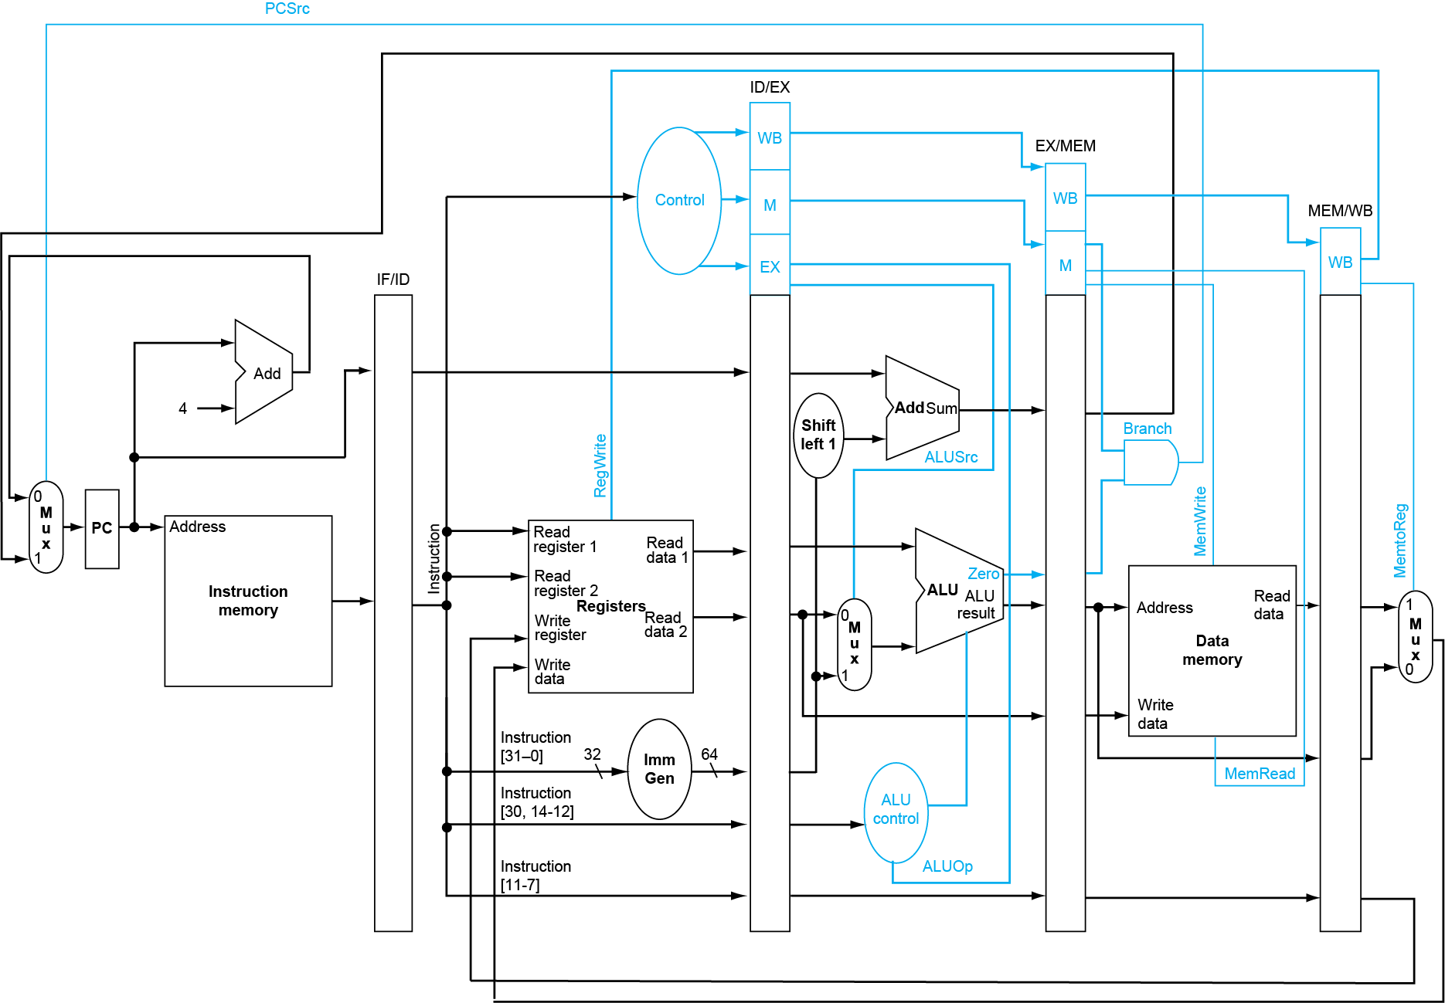
Three Basic Elements in Codasip
Registers -> defined in ca_resources
Codasip Memory Elements – added with functions
Combinational Blocks – created in the code

Slide 6
Overall Functional View
All registers are updated SIMULTANEOUSLY
Instruction Memory
s_id_xx
Register File (Read)
Register File (Write)
s_ex_xx
Combinational Logic
IN ORDER
Data Memory
s_wb_xx
s_STG_xx
New r_*
New r_*
r_pc
May be r_STG_xx
Comb. Logic
r_id_xx
r_ex_xx
r_me_xx
r_wb_xx
clock

Slide 7
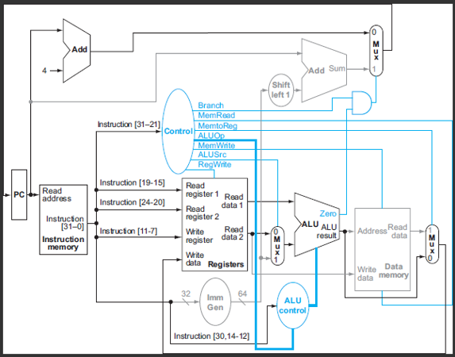
Homework #3
This is Figure 4.19 used in the Homework.
A “control signal” is asserted if it in the active state
A “resource block” is used if data flowing through it affects the value of an updated state element

Slide 8
Phase 6
DEBUG, DEBUG, DEBUG

Slide 9
Forwarding Analysis
Adding nops to Avoid Hazards
Forwarding Implemented
None
<- 2
<- 0
<- 2
<- 0
<- 0
<- 1
<- 0
<- 2
MEMWB
<- 1
<- 0
<- 1
<- 0
<- 0
<- 0
<- 0
<- 1
Both EXMEM and MEMWB
<- 0
<- 0
<- 1
<- 0
<- 0
<- 0
<- 0
<- 0
add x1, x2, x3
xori x4, x1, 47
lw x5, 24(x1)
bltu x4, x5,-40
or x7, x5, x7
sltiu x5, x1, x4
sh x7, 36(x1)
and x7, x5, x1
lw x8, -40(x7)

Slide 10
Pipeline Performance
Processor Clock Frequency
5 pipeline stages of a RISC-V CPU
IF (Instruction Fetch) 200ps
ID (Instruction Decode) 150ps
EX (Execution) 250ps
MEM (Memory Access) 200ps
WB (Write Back) 100ps
Single cycle instruction cycle time?
Single cycle instruction latency?
Pipelined cycle time?
Pipelined latency?
Divide 1 stage – which one?
900 ps
900 ps
250 ps
1250 ps
EX
900 ps
900 ps
200 ps
1200 ps

Slide 11
Stalls and performance
Stalls reduce performance
But are required to get correct results
Compiler can arrange code to avoid hazards and stalls
With different hardware implementations of the RISC-V ISA, can the compiler optimize or work around hazards for all implementations with different pipeline structures?
No, requires knowledge of the pipeline structure to avoid hazards and to optimize performance on a specific RISC-V implementation
Hazard detection and forwarding can eliminate or reduce the number of stalls that the compiler cannot prevent

